Slide 1
BELIEF
CHAPTER 5

Slide 2
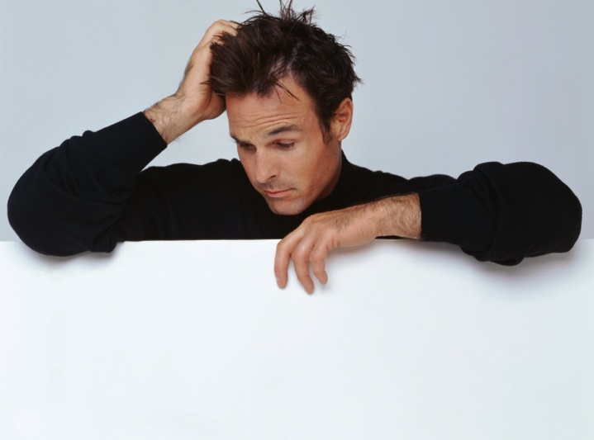
Celebrating belief
“The good news is that half of the material you learn in medical school will survive all scrutiny and investigation. It will be enduring. The other half of what we teach you, however, will be proven incorrect. The bad news is we have no way of knowing which half is which!”
Notes:
A professor announced to a brand new class of medical students: “I have good news and bad news: The good news is that half of the material you learn in medical school will survive all scrutiny and investigation. It will be enduring. The other half of what we teach you, however, will be proven incorrect. The bad news is we have no way of knowing which half is which!”

Slide 3
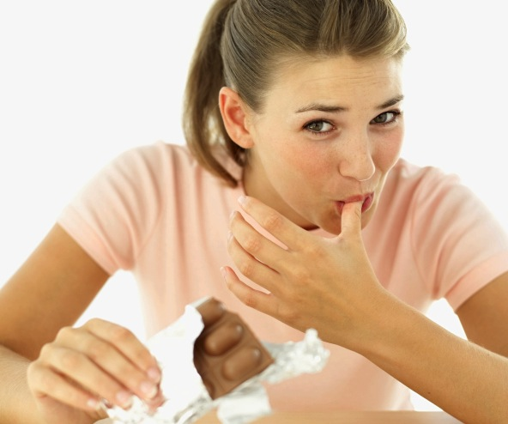
What to believe?
Notes:
In today’s world it’s sometimes difficult to know what to believe about much of the information we’re “fed”! One day we read that drinking alcohol is harmful. The next week other reports indicate that it’s protective of good health. Chocolate is fattening, right? Wait a minute—now a research group has reported that it actually helps people lose weight. Coffee is harmful, we’ve been told. But then we learn that in a significant study those who drank large amounts of coffee lived longer! And one week a major tech company introduces another time-saving, “must have” device; the next week media report those claims as based on unreliable analyses.

Slide 4
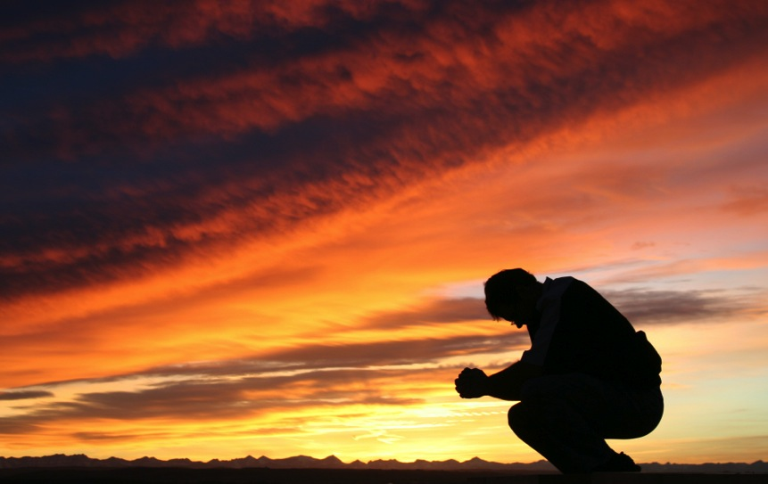
Belief is essential to human existence
Notes:
In what or whom can we truly believe? Sometimes determining the answer to this question is tough! Yet, we all believe in something. The greatest skeptics have beliefs, even if it’s the belief that no one can be trusted. The survival of all humans is based on beliefs of some kind. Belief is essential to human existence and organization.

Slide 5


Power of belief
Notes:
One day a physician was examining a patient who complained about a myriad of symptoms, unrelated to any known syndrome or disease complex. The patient told the doctor that perhaps an evil spell had been cast on him and was making him ill. The doctor then took two small glass tubes and filled one with hydrogen peroxide and the other with water. The patient didn’t know the two liquids were different. The physician then drew a small amount of blood from the patient and put a few drops into the tube with the hydrogen peroxide. Naturally, there was an immediate reaction of effervescence, and the doctor knowingly nodded. “Ah-ha,” he said, “you will benefit from this.” He then gave the patient a saline injection and told him to wait in the waiting room.

Slide 6
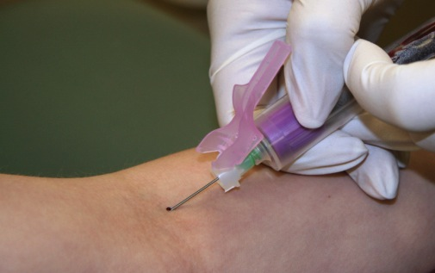
Doctor drew a small amount of blood
Notes:
After a short time the doctor called the patient back into his office and again drew a small amount of blood, this time putting a few drops into the tube containing plain water. As expected, it mixed without any reaction. The doctor told the patient that the evil spell had been broken, and the patient left feeling immensely better. The story goes that the patient told all his friends about how he had been healed, and many of them came to the doctor wanting the same treatment!

Slide 7

Place our belief and trust in
that which is reliable
Notes:
As this story demonstrates, there is tremendous power in belief. For many a peddler of “quack medicine,” this phenomenon is a mighty source of revenue. “Unscrupulous” salespersons can sometimes create a false need in the minds of their targets. They then sell herbal concoctions, nonessential mineral supplements, nutraceuticals (fortified foods or supplements), special diets, and magnetic or electrical cures mediated through empty black boxes or mild shock-emitting equipment. They are trading on what can be called the “gullibility factor.” For those who are healthy, the only cost is some money, from which they are soon parted. In a situation in which something such as cancer is involved, sometimes the delay before undertaking more traditional treatment leads to a deadly outcome as well as the wasting of limited and precious resources on worthless “cure-alls.” It’s important to place our belief and trust in that which is reliable and not on such unproven methods.

Slide 8
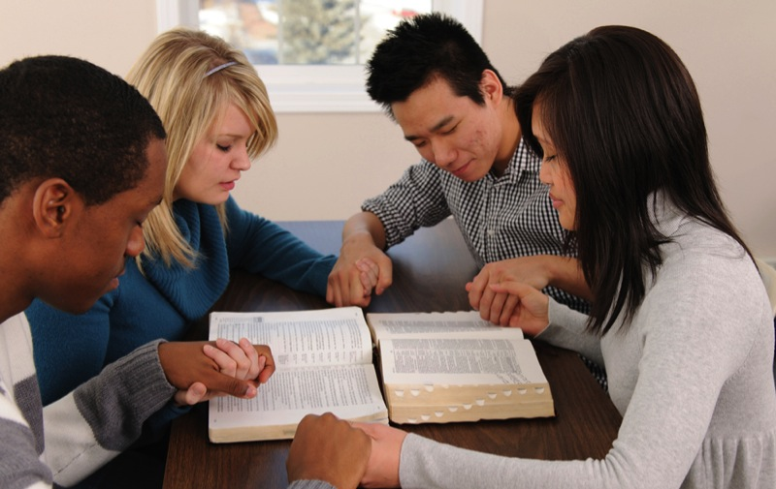
Belief—or faith, within a religious setting…
Notes:
Belief—or faith, within a religious setting—has been shown to have statistically significant benefits that exceed the placebo effect. When the religious experience of Americans who reached the age of 100 was studied, researchers found that religiosity significantly enhanced health. Although many questions are still unanswered, the benefits of trust in God result from more than simply attending religious services.¹

Slide 9
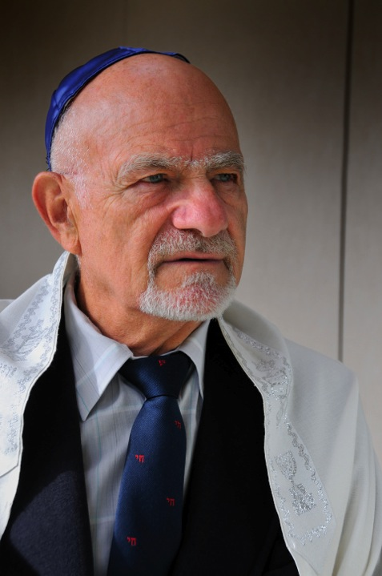
A decreased mortality rate over a 15-year follow-up in the religious group
Notes:
A study comparing mortality rates between secular and religious kibbutzim (collective agricultural communities in Israel), found a decreased mortality rate over a 15-year follow-up in the religious group. The age-adjusted risk of premature death of members of the secular kibbutz was 1.8 times higher for males and 2.7 times higher for females when compared with the religious kibbutz.²

Slide 10
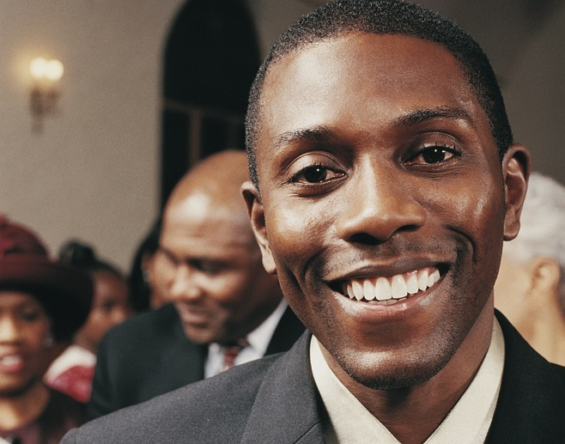
Religious activities…improved health…
Notes:
A study of African-Americans found that those who engaged in organized religious activities had improved health and life satisfaction.3 Duke University researcher C. G. Ellison found that a lack of religious affiliation increases the risk of depression in African-Americans.⁴

Slide 11

There is a connection between social relationships and survival
Notes:
A connection between social relationships and survival has been documented in several studies. C. J. Schoenbach, et al. have documented this effect, particularly among white males.⁵

Slide 12
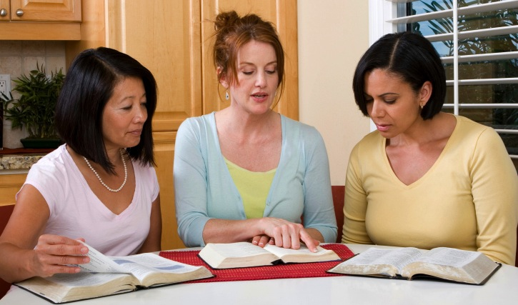
Improved quality of life
Notes:
Improved Quality of Life
One of the most consistent findings across all racial groups is that spirituality profoundly improves the quality of life. Ellison describes these significant benefits, brought about by exercising faith:⁶
Religious attendance and private devotion strengthen a person’s religious belief system.
Strong religious systems, when accompanied by a high level of religious certainty, have a substantial and positive influence on well-being.
Individuals with strong religious faith report higher levels of life satisfaction, greater personal happiness, and fewer negative psychosocial consequences of traumatic life events.

Slide 13
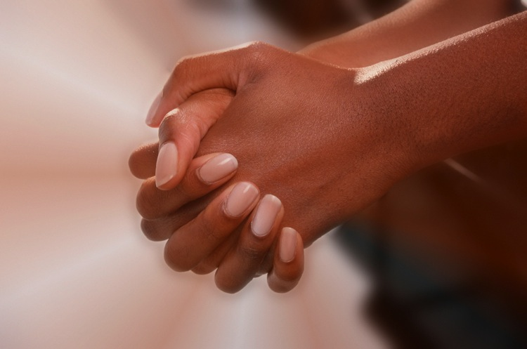
Spirituality helps believers and non-believers in their community
Notes:
Spirituality not only helps believers but also benefits the nonbelievers in their community. Research has found that communities gain health benefits when they have higher numbers of adherents to faiths that emphasize implicit obedience to God and His standards of conduct.⁷ The reason that nonbelievers are benefitted as well is likely that their social norms favor conformity to the more healthful lifestyle embraced by their religious neighbors.
Religious people—particularly adolescents from religious homes who frequently attend religious services, pray, and read Scripture—have fewer problems with alcohol, tobacco, or other drugs than do their nonreligious peers.⁸
Religion was also positively associated with emotionally healthful values and socially accepted behaviors such as tutoring or other volunteer activities often promoted by religious organizations.⁹

Slide 14
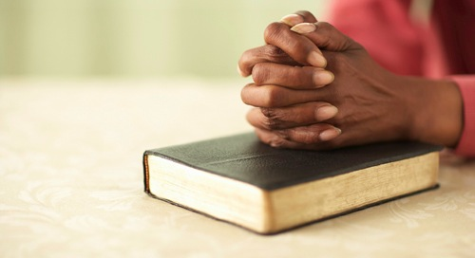
Belief in a loving God produces a positive and health-promoting mind
Notes:
Harold G. Koenig, M.D., discusses the findings of Idler and Kasl. These researchers noted a connection between healthier emotional lives and closer social ties in religiously active people, which often resulted in lower levels of disability. The increased physical activity associated with leisure and social activities did not fully account for the increased benefits in these people’s lifestyles, and the authors concluded: “A significant effect of religiousness remains even after social activities have been considered.”¹°
Thus, we find that belief in a loving God produces a very positive and powerful health-promoting state of mind. There is nothing more reassuring than the peace and satisfaction experienced by those who place their lives in the hands of a loving God and who are aware of His love for them. This brings health, happiness, and a sense of purpose. As the Bible says, “Those who love your instructions have great peace and do not stumble” (Ps. 119:165, NLT).

Slide 15
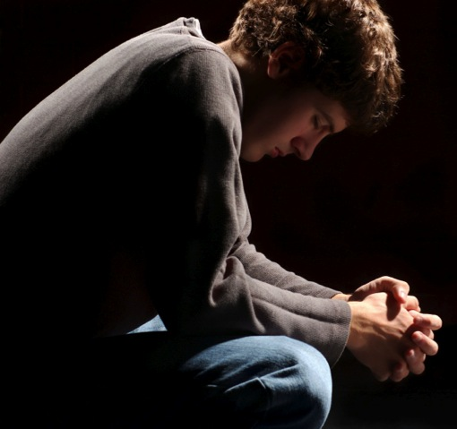
Stress issues
Belief in God may be associated with reduction in stress, depression, and loneliness.
Notes:
Belief in God may be associated with reduction in stress, depression, and loneliness. A 1990 Gallup poll revealed that more than 36 percent of Americans live with chronic feelings of loneliness. According to a Princeton University Research Associates survey, at least two thirds of Americans feel stressed at least once a week. Stress, loneliness, and related depression can have serious consequences. Between 75 and 90 percent of all doctor visits contain components relating to stress.¹¹

Slide 16
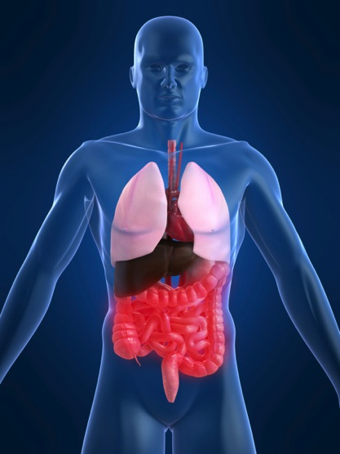
Stress weakens body organs, over time
Notes:
Medical science has discovered that when you feel stressed as a result of facing challenges, the negative emotions trigger the release of certain hormones that stimulate the nervous system in such a way as to put stress on the various organs of the body. If these organs are subjected to stress over long periods of time, they become weakened. Once weakened, they are more susceptible to a variety of disease processes. The order and intensity with which organs are affected depend upon the person’s heredity, constitution, environment, and lifestyle. For example:

Slide 17
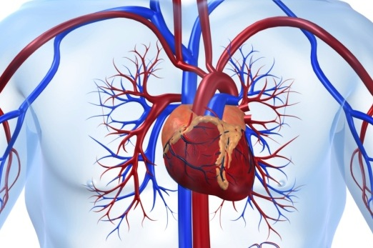
Stress can cause heart palpitations
Notes:
Stress may cause the release of adrenaline, making the heart beat more rapidly and powerfully. Such stress can cause one to suffer from heart palpitations (unpleasant awareness of heartbeat).

Slide 18
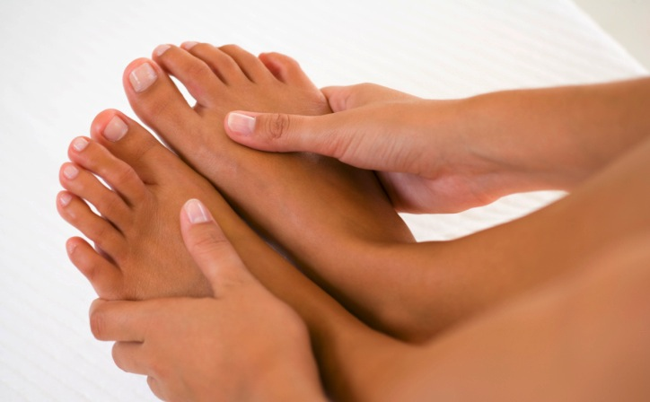
Cold hands and feet
Notes:
When stress hormones cause the blood vessels to constrict, they may augment the effects of hypertension and cause diminished peripheral vascular flow, leading to cold hands and feet.

Slide 19
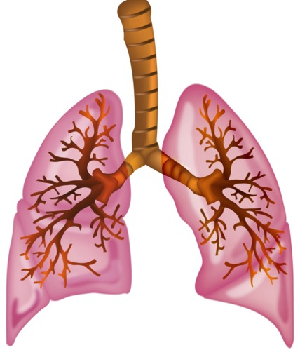
Stress may induce shallow
and rapid breathing
Notes:
Stress may induce shallow and rapid breathing with bronchial dilation, which causes hyperventilation.

Slide 20
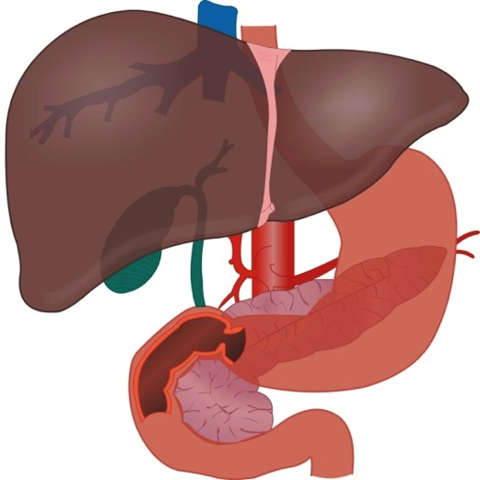
Stress may affect the digestive process
Notes:
Stress results in diversion of the blood supply away from the digestive system, possibly affecting digestive processes.

Slide 21
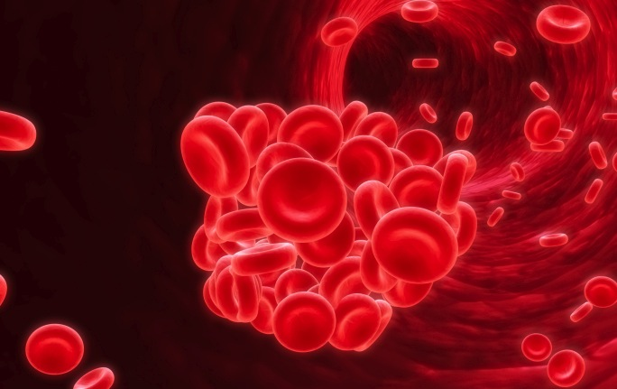
Stress induces clotting of the blood
Notes:
Stress induces a state of increased clotting of the blood; though protective in some circumstances, it could have detrimental effects in others.

Slide 22
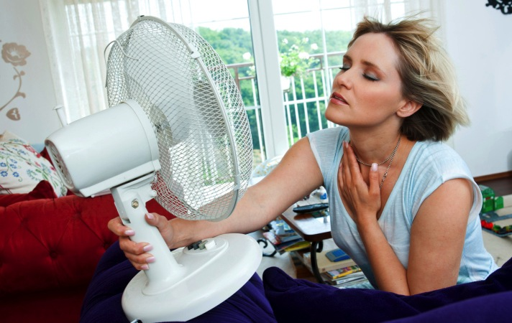
Chronic stress may increase perspiration
Notes:
Chronic stressful conditions may increase perspiration, leading to unpleasant dampness.

Slide 23
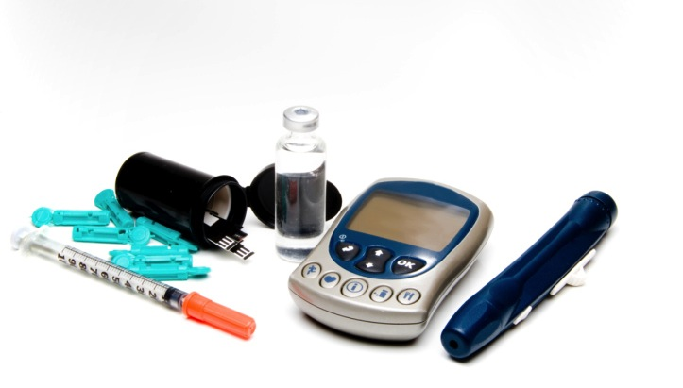
Chronic stress may lead to diabetes
Notes:
Stress causes an increase in blood glucose (to serve as a rapid source of energy); in those predisposed to diabetes, chronic stress may lead to the hastening of the onset or exacerbation of diabetes mellitus. Stress may cause alterations in gastrointestinal and urinary functions. Some may suffer from urinary frequency and irritable bowel syndrome.

Slide 24

Stress may cause numerous physical complaints
Notes:
A stressed person may visit the doctor for numerous physical complaints and suffer from emotional disorders such as anxiety, depression, phobias, cognitive disorders, memory problems, and sleep disorders.

Slide 25

Benefits of prayer
The path of those who live right is like the early morning light. It gets brighter and brighter until the full light of day.
Proverbs 4:18, ERV
Notes:
An Ohio study¹² examined the effects of prayer on well-being. Of the 560 respondents, 95 percent classified themselves as religious people; 54 percent were Protestants and 25 percent Catholics. Four types of prayer were identified:

Slide 26
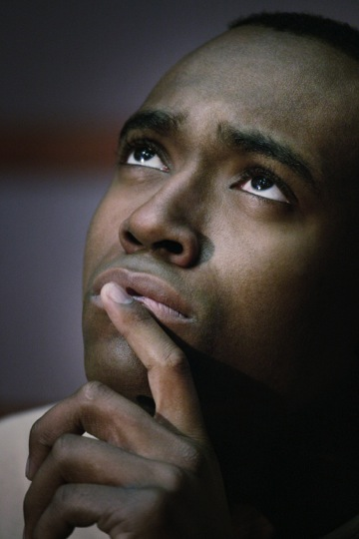
Four types of prayer
Petitionary prayer
Ritual prayer
Meditative prayer
Colloquial prayer
Notes:
Petitionary prayer: asking for material things you may need.
Ritual prayer: reading the book of prayers.
Meditative prayer: “feeling,” or being, in His presence.
Colloquial prayer: talking as to a friend and asking God for guidance in making decisions.

Slide 27
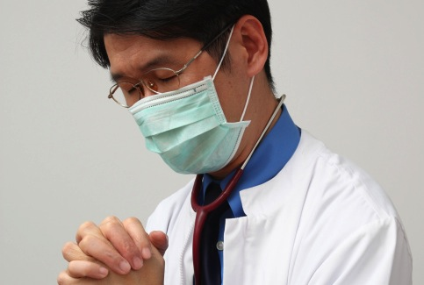
Role of prayer in healing
Notes:
Of all these types of prayer, this study revealed that colloquial prayer correlates best with happiness and religious satisfaction; whereas, ritual prayer was associated with a negative effect producing feelings all the more sad, lonely, tense, and fearful. Talking to God as to a friend, telling Him all our joys and sorrows, can bring happiness, healing, and religious satisfaction. So important is the role of prayer in healing that Dr. Larry Dossey said, “I decided that not to employ prayer with my patients was the equivalent of withholding a potent drug or surgical procedure.”¹³

Slide 28
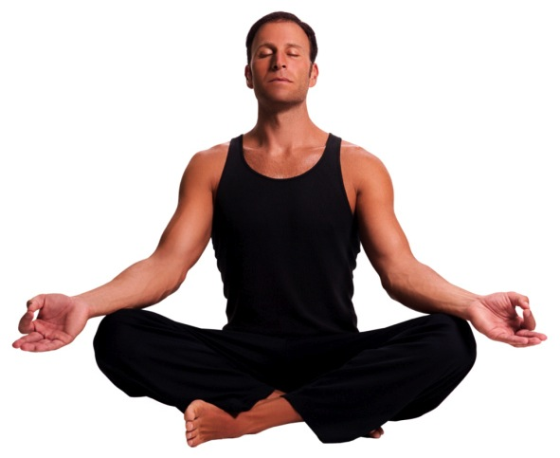
Many have tried self-empowerment
Notes:
Many people have tried to solve their problems through yoga, secular meditation, or some similar internalized program of self-empowerment; however, these methods do not have the same effectiveness. In many cases they are techniques of self-hypnosis.

Slide 29
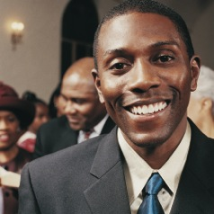
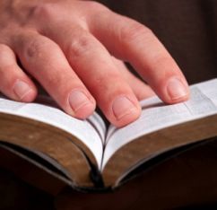
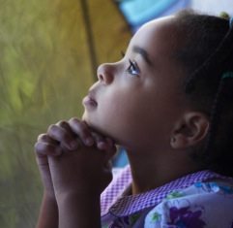
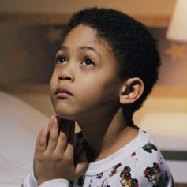
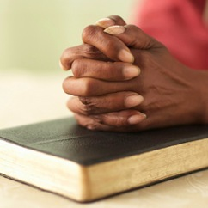
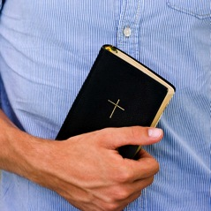
Celebrate belief—it’s the foundation of life!
Notes:
Most civilizations have been founded on a set of beliefs and moral values that lead to an orderly society. Throughout the centuries belief in spiritual values has been a strong motivator to treat others well and to develop peaceful human relationships. History demonstrates that faithless and amoral societies become so corrupt that they cannot survive. Belief is fundamental to science as well as to religion. Just as faith in a scientific principle is verified, faith in God is validated when tests show that its application leads to correct conclusions and brings satisfying results. Studies indicate that those with regular spiritual practices who meet with a faith community live longer, live better, and are far less likely to have a stroke or heart attack. Faith can provide strength to overcome stress and destructive habits. Belief can give you peace of mind and enable you to reach your full potential through positive choices. Celebrate belief—it is the foundation of life!

Slide 30
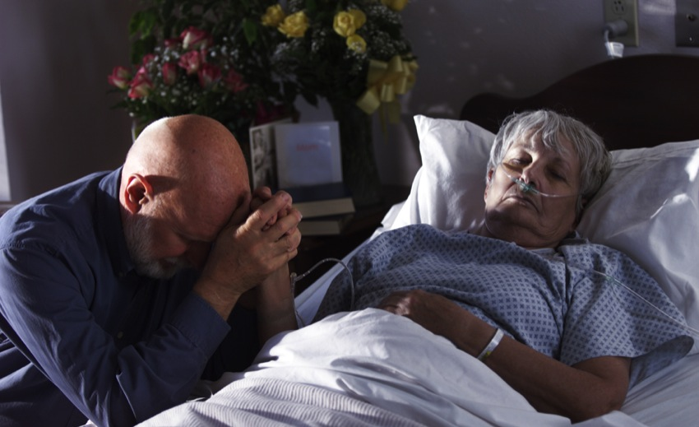
Peace of mind
Notes:
The Bible says, “You will keep him in perfect peace, whose mind is stayed on You, because he trusts in You. (Isa. 26:3, NKJV). When we have a close relationship with God, we experience peace of mind.
This does not mean that those who believe in God and trust Him implicitly will be free from problems. “Trouble and turmoil may surround us, yet we enjoy a calmness and peace of mind of which the world knows nothing. This inward peace is reflected in a . . . vigorous, glowing experience that stimulates all with whom we come in contact. The peace of the Christian depends not upon peaceful conditions in the world about him but upon the indwelling of the Spirit of God.”¹⁴

Slide 31
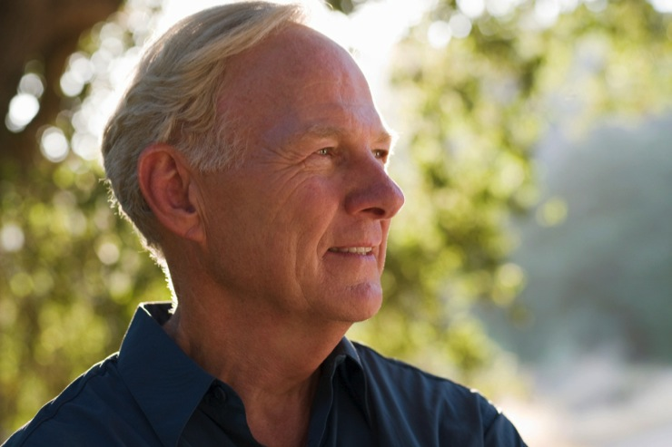
“Trust in God, and you will never be confounded in time or eternity.” Dwight L. Moody
Notes:
As nineteenth-century evangelist Dwight L. Moody is quoted by many as saying:
“Trust in yourself, and you are doomed to disappointment.
“Trust in your friends, and they will die and leave you.
“Trust in money, and you may have it taken from you.
“Trust in reputation, and some slanderous tongue may blast it.
“But trust in God, and you will never be confounded in time or eternity.”
Trusting in a loving, powerful God provides us with the ability to enjoy a healthful lifestyle. Belief and faith in God enables Him to fill our lives with abundant peace and joy.

Slide 32

LIFE APPLICATION QUESTIONS
Notes:
LIFE APPLICATION QUESTIONS

Slide 33
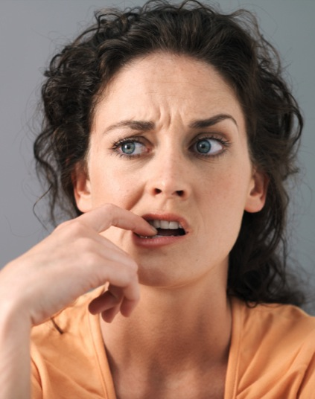
How gullible am I?
What methods do I use when choosing what to believe?
Notes:
How gullible am I?
What methods do I use when choosing what to believe?

Slide 34

Which influences can I trust?
The internet
Advertisements
Notes:
Which influences can I trust?
the internet,
advertisements,

Slide 35
Research backed by vested interests
Friends
Past experience
Notes:
research backed by vested interests,
friends,
past experience?

Slide 36
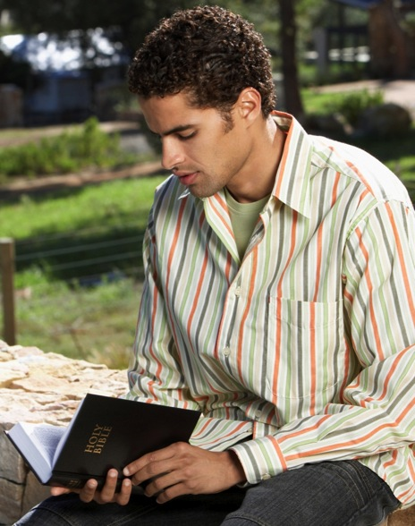
What benefits have I noticed by having faith in God?
Notes:
What benefits have I noticed by having faith in God?

Slide 37

How well have I coped with stressful situations?
Do I feel peaceful most of the time?
Notes:
How well have I coped with stressful situations? Do I feel peaceful most of the time?

Slide 38

Do I have a strong purpose in life?
Notes:
Do I have a strong purpose in life?

Slide 39

Is the community in which I live and work aware of this, and are they benefitting, as well?
Notes:
Is the community in which I live and work aware of this, and are they benefitting, as well? Are adolescents in my community better protected from disruptive and risky behaviors because of my association with them and the faith I exhibit?

Slide 40

Are adolescents in my community better protected from disruptive and risky behaviors because of my association with them and the faith I exhibit?
Notes:
Are adolescents in my community better protected from disruptive and risky behaviors because of my association with them and the faith I exhibit?

Slide 41
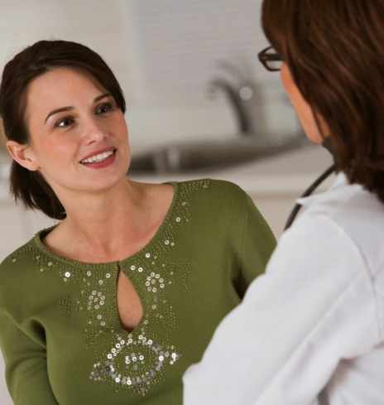
Which of the effects of stress have I experienced?
Notes:
Which of the effects of stress have I experienced?

Slide 42

How many visits to physicians could possibly be related to my not having an ongoing, meaningful relationship of trust with my Savior?
Notes:
How many visits to physicians could possibly be related to my not having an ongoing, meaningful relationship of trust with my Savior?

Slide 43

Do I need to spend more time growing my faith through the study of God’s Word and association with those who have the same beliefs I do?
Notes:
Do I need to spend more time growing my faith through the study of God’s Word and association with those who have the same beliefs I do?

Slide 44
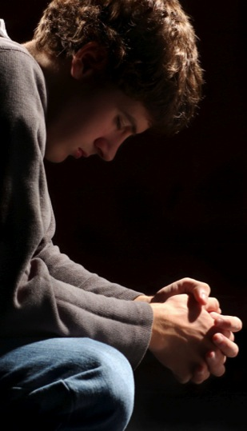
A classmate of Bruce from academy days has stopped attending church. He had a few bad experiences and doubts God’s interest in his life situation.
Notes:
A classmate of Bruce from academy days has stopped attending church. He had a few bad experiences and doubts God’s interest in his life situation.

Slide 45
What would I have done if those things had happened to me?
Notes:
What would I have done if those things had happened to me?

Slide 46
What would I have done if those things had happened to me?
Would my faith have been stronger?
Notes:
Would my faith have been stronger?

Slide 47
What would I have done if those things had happened to me?
Would my faith have been stronger?
How can I encourage Bruce?
Notes:
How can I encourage Bruce?

Slide 48

Can I choose to start a fellowship group or small-group Bible study?
Notes:
Can I choose to start a fellowship group or small-group Bible study?

Slide 49
What particularly encouraging experiences can I share with him?
Notes:
What particularly encouraging experiences can I share with him?

Slide 50

Which of the four types of prayer do I practice most often?
Notes:
Which of the four types of prayer do I practice most often?

Slide 51
In what ways can I change my prayer habits in order to become more joyful and inwardly peaceful even amid tumultuous events?
Notes:
In what ways can I change my prayer habits in order to become more joyful and inwardly peaceful even amid tumultuous events?

